Slide 1
Chapter 2
Indigenous Sacred Ways

Slide 2
Learning Objectives (1 of 2)
2.1 Outline the challenges faced by scholars in understanding indigenous sacred ways.
2.2 Explain the cultural diversity of indigenous groups.
2.3 Describe the circle of right relationships.
2.4 Identify the different spiritual specialists in indigenous sacred ways

Slide 3
Learning Objectives (2 of 2)
2.5 Summarize group and individual observances in indigenous sacred ways.
2.6 Illustrate how the processes of globalization are affecting indigenous peoples.
2.7 Discuss how development projects have affected indigenous peoples and how they have responded.

Slide 4
“I am a child of both worlds. Despite being a university professor, and one who has embraced modernity, I am still a Maasai girl deep down.”
Damaris Parsitau
Notes:
Damaris Parsitau, personal communication with textbook author, 30 June and 1 July 2011.

Slide 5
Goals of this chapter
Introduce and explain what an indigenous religion is;
Help us appreciate why it is difficult to understand these religions and the current perils of their existence; and
Present key common features of indigenous religions with particular emphasis on their views of humanity’s relationships with spirits, creation, and power.

Slide 6
Indigenous Sacred Ways
A great many people have at least heard of some of the major global religions, such as Buddhism, Christianity, Hinduism, Islam, and Judaism, fewer may be familiar with the religions and sacred ways of traditional indigenous peoples, or the descendants of the original inhabitants of lands now controlled by larger political systems

Slide 7
Indigenous Sacred Ways
The sacred ways of indigenous peoples that are passed down from generation to generation are referred to as Indigenous Religions.
Their followers constitute roughly 4 percent of the world’s population.
While globalization has diluted sacred ways in some cases, it has also helped them to spread internationally.

Slide 8
2.1 Understanding indigenous sacred ways
Indigenous sacred ways have traditionally been little understood by outsiders.
Many indigenous traditions have been practiced in secret, and until recently, those who have attempted to comprehend them had little preparation or background for doing so.
For instance, anthropologists who tried to ferret out the native sacred ways did so from a Western nonspiritual perspective.

Slide 9
2.1 Understanding indigenous sacred ways
Recognizing that such inquirers did not accept the truth of their beliefs and practices, native peoples protected the sanctity of their ways from nonbelievers hiding them or going underground.

Slide 10
2.1 Understanding indigenous sacred ways
[The] Western worldview is closed, essentially complete and unchangeable, basically substantive and fundamentally non-mysterious; i.e. it is like a rigid programmed machine…
This closed worldview is foreign to Africa, which is still deeply religious. … This world is not closed, and not merely basically substantive, but it has great depth, it is unlimited in its qualitative varieties and is truly mysterious; this world is restless, a living and growing organism.
“Gerhardus Cornelius Oosthuizen, a South African scholar”

Slide 11
2.1 Understanding indigenous sacred ways
To protect their beliefs, some indigenous peoples have used the tactic of giving false information to outside inquirers.
Indigenous spirituality may be seen as a lifeway, or particular approach to all of life, rather than something expressed only at certain times or places.
In most native cultures, spiritual lifeways are shared orally, without formal sacred scriptures.
In addition, the practices and teachings of indigenous peoples are transmitted internally from one generation to the next.
Because of this dynamic, outsiders may experience barriers to comprehending indigenous religious beliefs and practices.

Slide 12
2.1 Understanding indigenous sacred ways
Today there are encouraging indications that some common ground between these religions and those on the outside is emerging.
In particular, some traditional elders are beginning to share their core values regarding reverence for the earth with others because of their concerns about current ecological developments.
Members of global religions (and others) are coming to a new appreciation for the profundity and value embedded in indigenous sacred ways, particularly with respect to the environment.

Slide 13
2.2 Cultural diversity
As a whole, indigenous forms of spirituality exhibit traditions that developed within a spectrum of cultural, religious, and material diversity.
Some indigenous cultures have been highly developed, whereas others still embody a basic strategy of survival (e.g., Australian Aborigines).

Slide 14
2.2 Cultural diversity
Diversity manifests itself in other areas as well. Such groups may live in somewhat sheltered ancestral enclosures or large contemporary urban areas.
Despite the real differences in cultural origins, indigenous traditional ways do manifest some common characteristics. It would be overgeneralizing to ascribe specific beliefs to all native peoples, but there are some concepts and ways of approaching the universe that are common to many of them.

Slide 15
2.2 Cultural diversity
Groups whose material culture is simple nonetheless may have highly complex cosmogonies, or models of the origins of the universe and their purpose in it.
Diversity manifests itself in other areas as well. Such groups may live in somewhat sheltered ancestral enclosures or large contemporary urban areas

Slide 16
2.2 Cultural diversity
They also vary in the degree of adaptation to and absorption of the dominant religions in their regions (e.g., indigenous African religious traditions fused with Christianity in the context of slavery, such as Vodou).
Despite the real differences in cultural origins, indigenous traditional ways do manifest some common characteristics. It would be overgeneralizing to ascribe specific beliefs to all native peoples, but there are some concepts and ways of approaching the universe that are common to many of them.

Slide 17
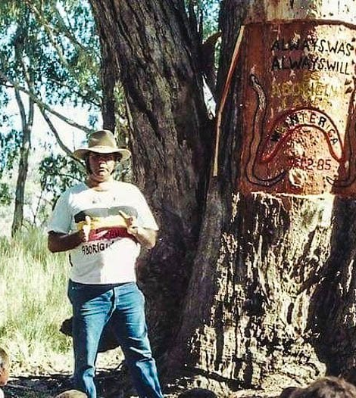
2.2 Cultural diversity
For many indigenous peoples, everything is interrelated
To Australian Aborigines, before time began there was land, but it was flat and devoid of any features.
Powerful ancestral beings came forth from beneath the surface and began moving around, shaping the land as they moved across it.

Slide 18
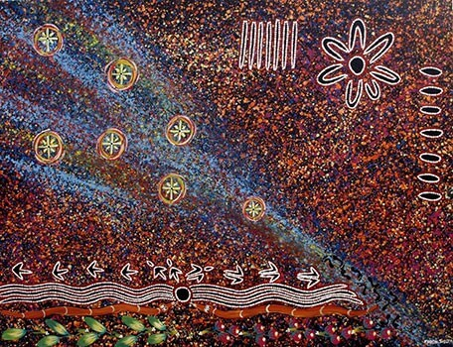
What is the circle of right relationships?
Dreamtime: the time before the world began
In this “Dreamtime,” the ancestral figures also created groups of humans to take care of the places that had been created.
The people thus feel that they belong to their native place in an eternal sacred relationship.

Slide 19
What is the circle of right relationships?
Many indigenous religions hold that everything in the universe, all forms of life, is interrelated and interdependent. This belief pervades all of the common themes explained in the chapter.
Often, but not always, the symbol for this interrelationship or unity is the circle.
Because this form has no beginning and no endpoint, it can symbolize the ongoing cycle of birth, youth, maturity, and death.
It can also symbolize the return of the seasons, or the cyclical movements of the sun, moon, planets, and stars.

Slide 20
2.3 The circle of right relationships
Many indigenous religions hold that everything in the universe, all forms of life, is interrelated and interdependent. This belief pervades all of the common themes explained in the chapter.
Often, but not always, the symbol for this interrelationship or unity is the circle.
Because this form has no beginning and no endpoint, it can symbolize the ongoing cycle of birth, youth, maturity, and death.
It can also symbolize the return of the seasons, or the cyclical movements of the sun, moon, planets, and stars.

Slide 21
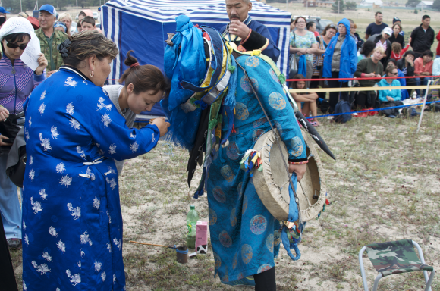
Cultural diversity Why are indigenous groups culturally diverse?
The Buryats living near Lake Baikal in Russia were thought to have been converted to Buddhism and Christianity centuries ago; however, almost the entire population of the area gathered for indigenous ceremonies on Olkhon Island in 1992 and 1993.

Slide 22
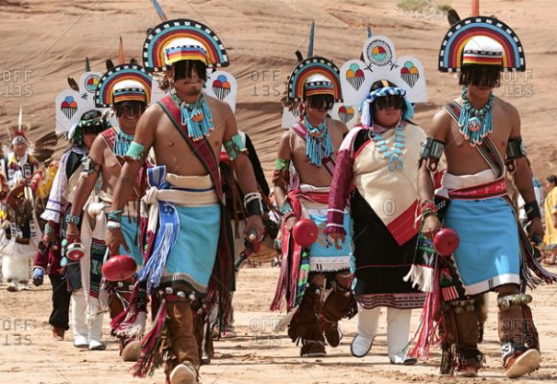
Cultural diversity Why are indigenous groups culturally diverse?
Some traditional peoples live in their ancestral enclaves, though not untouched by the outer world.
The Hopi people have continuously occupied a high plateau area of the southwestern United States for between 800 and 1,000 years; their sacred ritual calendar is tied to the yearly farming cycle
Tribal peoples have lived in India for thousands of years, but the forests they now occupy may not have been their primary homelands
Notes:
marginalized by higher-caste Hindus and then British colonizers

Slide 23
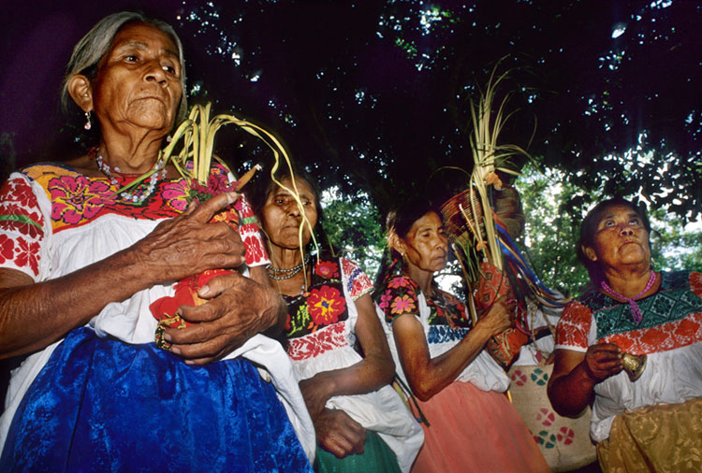
Cultural diversity Why are indigenous groups culturally diverse?
Other indigenous peoples visit their sacred sites and ancestral shrines but live in more urban settings because of job opportunities
The people who participate in ceremonies in the Mexican countryside include subway personnel, journalists, and artists of native blood who live in Mexico City
Notes:
marginalized by higher-caste Hindus and then British colonizers

Slide 24
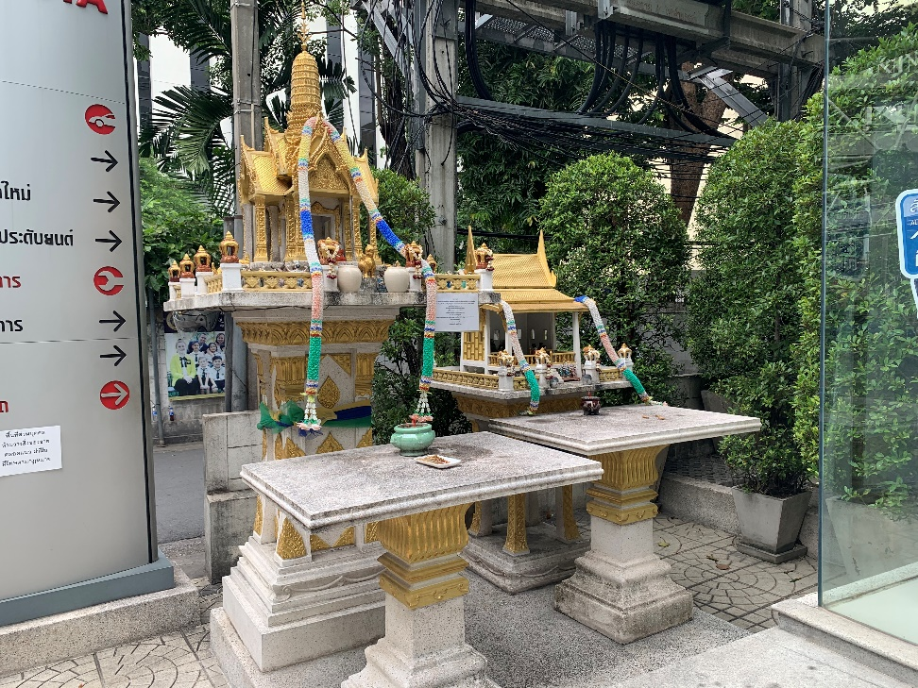
Cultural diversity Why are indigenous groups culturally diverse?
Indigenous traditions vary in their adaptations to dominant religions.
Often native practices have become interwoven with those of global religions, such as Buddhism, Islam, and Christianity.
Southeast Asia, household Buddhist shrines are almost identical to the spirit houses in which the people still make offerings to honor the local spirits
Notes:
marginalized by higher-caste Hindus and then British colonizers

Slide 25
2.3 Relationships with spirit
The cosmos is thought to contain and be affected by numerous divinities, spirits, and ancestors.
Many indigenous peoples worship Supreme Being, who is believed to have created the cosmos. This Being may be found in aspects of nature and is represented variously as male, female, or even androgynous.
Even though the Great Power is present in all places and things, the Power remains transcendent, that is, unseen and mysterious.

Slide 26
2.3 Relationships with spirit
Another aspect of the spirit realm involves the many unseen powers that are a part of daily life and work.
This Great Spirit is also sometimes thought to be collectively present in the souls of human beings, and thus ancestor worship is an important aspect of some indigenous beliefs.

Slide 27
Cultural diversity
In Africa, the spread of Islam and Christianity saw the introduction of new religious ideas and practices into indigenous sacred ways.
The encounter transformed indigenous religious thought and practice but did not supplant it; indigenous religions preserved some of their beliefs and ritual practices but also adjusted to the new sociocultural milieu.
Notes:
marginalized by higher-caste Hindus and then British colonizers

Slide 28
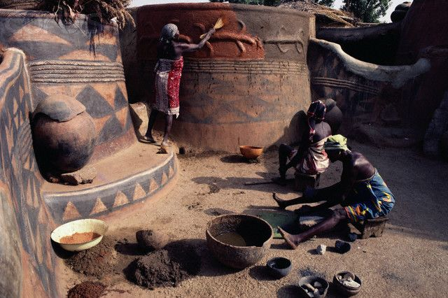
Relationships with spirit
The cosmos contain numerous divinities, spirits, and ancestors.
Many indigenous peoples worship Supreme Being, who is believed to have created the cosmos. This Being may be found in aspects of nature and is represented variously as male, female, or even androgynous.
To the Nankani of northern Ghana, ancestors have been delegated the power to take care of the needs and quarrels of their descendants, since they know and understand them well

Slide 29
2.3 Relationships with spirit
Another aspect of the spirit realm involves the many unseen powers that are a part of daily life and work.
This Great Spirit is also sometimes thought to be collectively present in the souls of human beings, and thus ancestor worship is an important aspect of some indigenous beliefs.

Slide 30
2.3 Relationships with spirit
In some West African groups, the pantheon of deities is called orisa or vodu.
Orisa are the embodiment of dynamic life forces that were created at the beginning of time by the one godhead.
Some analysts believe that orisa represent the archetypes of traits that exist within the human psyche, and by being attentive and in tune with these inner forces, one can return to a state of wholeness

Slide 31
Cultural diversity
Vodou: Latin American and Caribbean ways of working with the spirit world
The Dahomey tradition from West Africa was carried to Haiti by African slaves and called Vodou, from vodu, one of the names for the chief nonhuman spirits
Forced by European colonialists to adopt Christianity, worshipers of Vodou secretly fused their old gods with their images of Catholic saints.
Notes:
marginalized by higher-caste Hindus and then British colonizers

Slide 32
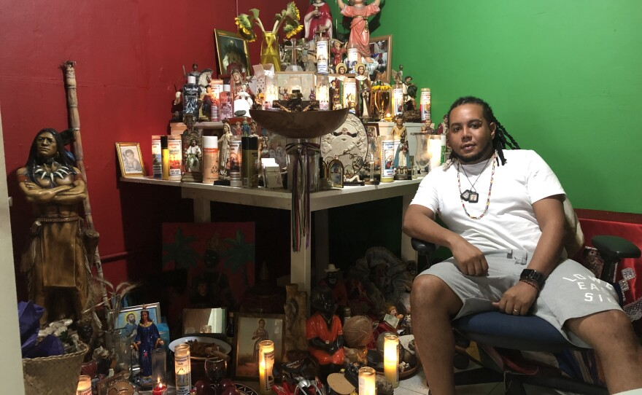
Cultural diversity Why are indigenous groups culturally diverse?
More recently, emigrants from Haiti have formed diaspora communities of Vodou worshipers in cities such as New York, New Orleans, Miami, and Montreal, where Vodou specialists are often called upon to heal sickness and use magic to bring desired change
Notes:
marginalized by higher-caste Hindus and then British colonizers

Slide 33
2.3 Kinship with all creation
Although spiritual power may remain unseen, all aspects of the tangible world are believed to be imbued with spirit.
Spiritual forces may be associated with venerable mountains or canyons, or they may be seen as animal spirit helpers, or personified elemental forces, or deceased ancestors who are still concerned about the lives of their relatives.
Reverent believers can call on these spirits as helpers, intermediaries between the people and power, and as teachers.

Slide 34
Kinship with all creation
Although spiritual power may remain unseen, all aspects of the tangible world are believed to be imbued with spirit.
Spiritual forces may be associated with venerable mountains or canyons, or they may be seen as animal spirit helpers, or personified elemental forces, or deceased ancestors who are still concerned about the lives of their relatives.

Slide 35
Kinship with all creation
Reverent believers can call on these spirits as helpers, intermediaries between the people and power, and as teachers.
Acquiring and maintaining right relationships with this aspect of the spirit world can constitute a sacred partnership.
Because of the intimate relationship the indigenous have with nature, forced removal from that environment can be devastating, taking away their identity.
Indigenous consider themselves to be caretakers of mother earth.

Slide 36
Relationships with power
Cultivating proper relations with spiritual energy or power is another common aspect among these religions.
Sometimes a specific site is believed to concentrate spiritual power.
Another source of spiritual power can be special sacred practices.
Using ritual objects and artifacts can be important.
Wearing clothing made of the fur of particular animals, for example, may increase one’s spiritual power.

Slide 37
Relationships with power
Visions or sharing a sacred pipe are still other practices involved with one’s relation to spiritual power.
Some groups consider women to have particular natural power, often especially during their menstrual periods.
If spiritual power is used for egoistic motives, the power can turn on the one possessing it.
One’s relationship with spiritual power is a sacred trust.
Acquiring power is not an end in itself. It is to be used for the good of others and the environment.

Slide 38
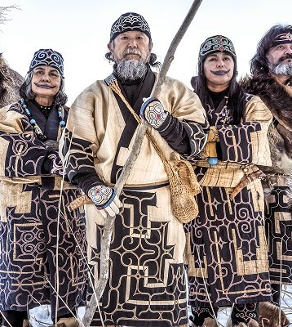
Relationships with power
In certain rituals in which both men and women participate, women’s menstrual blood is often thought to diminish or weaken the ritual or the men’s spiritual power.
In most Native American nations that have sweat lodge ceremonies for ritual purification, menstruating women are not allowed to enter the lodge.
A few cultures, such as the Ainu of Japan, have prized menstrual blood as a potent offering returned to the earth

Slide 39
2.4 Spiritual specialists
The indigenous worldview is that the Supreme Being is present in all places and fills all things, and anyone can interact with it.
Spiritual specialists within these religions dedicate themselves through special training and initiation to participate in activities involved with the world of the spirits.
These sacred roles can take several forms: storytellers, poets, tricksters or sacred fools, sacred clowns and dancers, priests and priestesses.

Slide 40
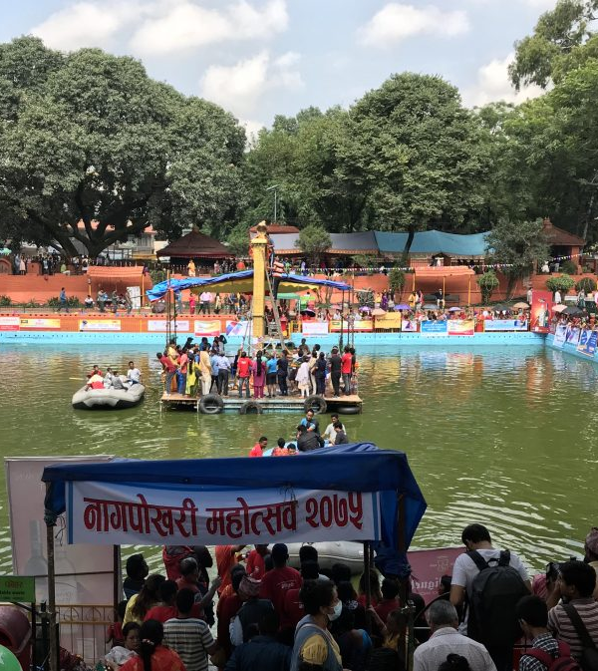
Relationships with spirit
These may include deities with human-like personalities, the nature spirits of special local places, such as venerable trees and mountains, animal spirit helpers, personified elemental forces, or the nagas, known to the traditional peoples of Nepal as invisible serpentine spirits who control the circulation of water in the world and also within our bodies
Naga Panchami, the Festival of Snakes

Slide 41
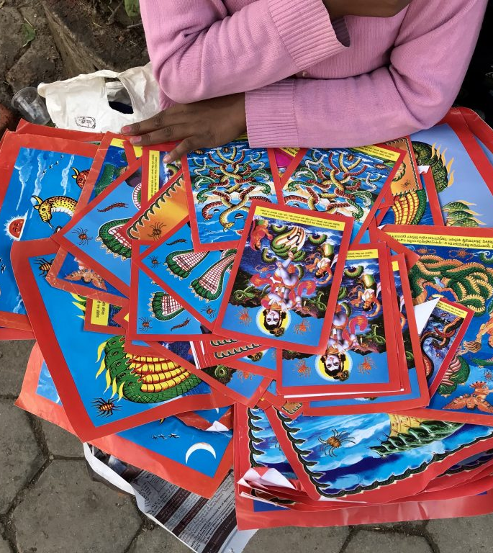
Relationships with spirit
Many unseen powers are perceived to be at work in the material world.
In addition to ancestors, some of these are perceived without form, as mysterious presences, who may be benevolent or malevolent.
Others are perceived as having more definite, albeit invisible, forms and personalities.

Slide 42
2.4 Storytellers and other sacred roles
Storytellers play a central role in indigenous religions, for it is they who memorize and transmit the sacred traditions.
Some storytelling traditions were lost during times when indigenous groups were subject to colonial rule.
Poets and musicians may also play a key role in preserving and transmitting traditions.
Secret societies for men and women are also common among indigenous religions.

Slide 43
2.4 Storytellers and other sacred roles
Members are initiated into secret traditions that may involve donning ceremonial dress as part of a ritual to establish contact with particular spirits.
Although men’s and women’s secret societies are separate, their rituals ultimately refer to the eternal Dreaming, in which male and female are not differentiated.
Sacred dancers likewise make the unseen powers visible through symbolic body movements.
In indigenous societies with some degree of social stratification, there may be specially trained priests and priestesses who are responsible for specific rituals that ensure a smooth relationship with the spirit world

Slide 44
2.4 Mystical Intermediaries
Modern medicine is beginning to adopt some of the approaches taken by these visionaries, who saw the physiological health of the individual as an expression of his or her psychological and sometime spiritual health.

Slide 45
2.4 Mystical Intermediaries
Most distinctive among the spiritual specialists are the shamans.
Shaman is a Siberian word that scholars use to refer to this group generically.
They are mystical intermediaries between the nonphysical and physical worlds who have attained this status either through heredity, a special gift, or initiation through certain religious ordeals.

Slide 46
2.4 Mystical Intermediaries
Initiation typically involves a death and rebirth experience.
Archaeological research indicates that the practices of the shaman probably date back twenty to thirty thousand years.
Native Americans speak of the mystical intermediary as a medicine person whose medicine power derives from an outside source.

Slide 47
2.4 Mystical Intermediaries
The shaman is often involved in physical, psychological, and social healing.
Shamans may travel to the spirit world to learn which spirits may be responsible for problems in the human world.
Most native religions see the shaman as a sacred and important person.
They view the rites of passage that she or he must endure as very dangerous rituals that are not to be taken lightly.

Slide 48
2.4 Mystical Intermediaries
Mystical intermediaries may undergo rites of purification, isolation, and bodily torment to make contact with the spirit world.
Usually, they have a guide or mentor to help them along the spiritual journey; the role may be hereditary or seen as a special gift.
A shamanic vision is not to be used merely for personal edification but rather is to be used with the group to see how the social order and the planet can be improved.

Slide 49
2.5 Group observances
Humans can help maintain the natural harmony of the world by practicing ritual observances.
These rituals are community-centered, as are indigenous ways in general.
Specific rituals aid the community in perceiving the extraordinary dimensions of the world within the realm of the ordinary.
Some of these rituals follow the major points of passage in the human life cycle: birth, naming, puberty, marriage, and death.
Some rituals support the group’s strategies for survival.
Other rituals are about the beginnings and sacred history of the people.

Slide 50
2.5 Group observances
Communities can also assemble for spiritual renewal and ritual purification.
Even pilgrimages to sacred sites are frequently communal.
An awareness of the place and community-centeredness of indigenous faiths and their rituals increases one’s sensitivity to the plight of those who are driven out of, or forcibly taken from, their native communities.

Slide 51
2.5 Group observances
Such people lose not only their individual identity but also their relationship to a tightly knit group and meaningful religious rituals.
Such awareness also helps explain the reluctance of some groups to share their rituals with non-indigenous people who wish to participate.
A sincere New Ager who wishes to join a sweat lodge ceremony for a few days, for example, may have little understanding of or connection to the community that performs the ritual.

Slide 52
2.5 Group observances
Indigenous groups whose communities are broken up by outside forces lose the power of their group rituals.
To reestablish communal ritual among African Americans, Professor Maulana Ron Karenga created the celebration of Kwanzaa, based on African “first fruits” harvest festivals.

Slide 53
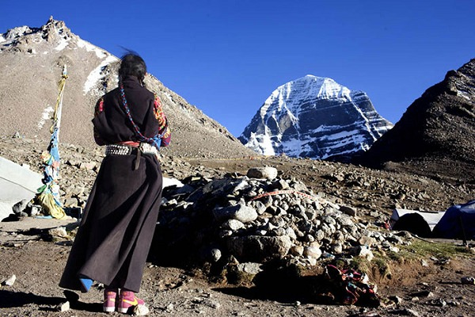
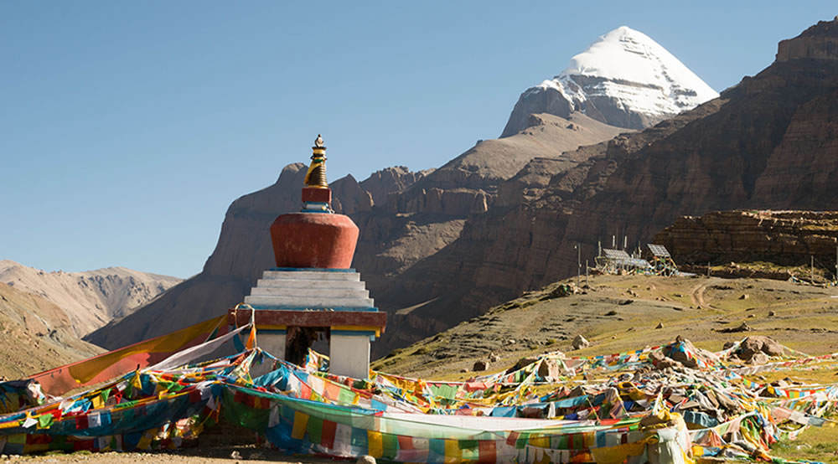
Kinship with all creation
Many traditional peoples know the earth as their mother.
Sacredness of nature
Striking features of the natural environment (mountain, canyon) may be perceived as the center from which the whole world was created
Tibet’s Mount Kailash
Notes:
seen by the indigenous people of that area as the center of the earth, a sacred space where the earthly and the supernatural meet

Slide 54
Individual observances
Balancing the communal dimension of ritual observance is individual observance.
For native sacred ways, it is considered important for individuals to experience a personal connection with the realm of the spirits.
Such connections are open to all people.

Slide 55
Individual observances
Shamans have a privileged relationship with the spirit realm; however, native religions have also been nicknamed democratized shamanism, stressing the idea that everyone has the opportunity to connect with the spirits.
Undergoing a vision quest (typically around the time of puberty) is a common means of access to the other world and may be a means of establishing a relationship with a guardian spirit

Slide 56
2.6 Globalization
Local spiritual traditions have suffered immensely from the onslaught of globalization processes.
People are seeing land for which they are caretakers taken over by others who demonstrate little regard for the environment or land.
Traditional sacred lifeways are thus being compromised and languages are being lost.

Slide 57
2.6 Globalization
Global religions are devaluing and suppressing indigenous ways.
While traditional spiritual wisdom has been obliterated in many parts of the world, many indigenous groups are negotiating the challenges of globalization in various constructive ways.
In particular, many are playing a key role in environmental preservation and conservation efforts.

Slide 58
2.7 Development issues
Contemporary issues involving indigenous religions revolve primarily around one central concern: the near obliteration of these responses to the sacred throughout the world.
Barriers to understanding these faiths discussed in the earlier part of this chapter demonstrate indigenous reactions to outside pressures and oppression.
The lands of these people have been seized, and development projects have often displaced indigenous peoples.

Slide 59
2.7 Development issues
Indigenous peoples have had their lands exploited by multinational companies for precious natural resources with devastating spiritual and economic consequences.
Attempts have been made to transform, or rather conform, their cultural identities and to replace their pathways to the sacred with other schemes of salvation.

Slide 60
2.7 Development issues
An irony amid this tragedy is that the indigenous worldview, which reveres all creation, recognizes the interdependence of all circles of life, and understands humanity’s relationship to mother earth as reciprocal-nurturing rather than domineering-subduing, may be precisely the necessary outlook to adopt to slow down and eventually stop the present ecological ravaging of the planet.
Some indigenous peoples believe that their traditional sacred ways are not only valid but actually essential for the future of the world

